Slide 1
Predictive Modeling II (Predict 411)
Northwestern University, School of Continuing Education
Masters Program in Predictive Analytics
Sync Session 2.0
January 15th, 2013
Vivek B. Ajmani, Ph.D.
Business Intelligence & Analytics Manager
Strategy & Patient Data Management
Cardiac Rhythm Disease Management
Medtronic, Inc.

Slide 2
Table of Contents
Admin Stuff
Week 1 Discussions (You Drive-Volunteers Anyone?)
Week 1 Assignments (You Drive-Volunteers Anyone?)
Week 2 Discussion (I drive)
Week 2 Assignment (I drive)
Week 1 + Finals (Both of us drive---Is this allowed?)
Where did this log “stuff” come from?
Intercept or No Intercept?
Conclusions

Slide 3
Week 1 + Finals
Assumptions behind OLS
  What are these?
  How are these detected?
    Example: Look at residuals
  How do we fix these?
    Look at the “following weeks” to determine these.
  Multicollinearity
    What is this?
    How is this detected?
    What can be done to rectify this?
  Frisch-Waugh Theorem, Goodness of Fit, Interpretations of the coefficients

Slide 4
Week 1 + Finals
What is the difference between the confidence interval for the mean response and the prediction interval?
Describe in your own words the Gauss Markov Theorem.
What is meant by Elasticity?

Slide 5
Week 1 + Finals
Dummy Variables Regression (OLS)
  Example: Gender (M, F) {Code 1=Males, 0=Females}
  Example: Education (BS, MS, PhD) {x1=1 if BS;0 otherwise. X2=1 if MS; 0 otherwise}
    BS x1=1 and x2=0
    MS x1=0 and x2=1
    PhD x1=0=x2

Slide 6
Week 1 + Finals
Wages = 2500 + 350*X1
  X1=1 if Males; 0 otherwise
What is the model for females?
  Wages_F = 2500 + 350*0=$2,500
What is the model for males?
  Wages_M= 2500 + 350(1)=$2,850
H0: Beta_1=0 versus H1: Beta_1<>0

Slide 7
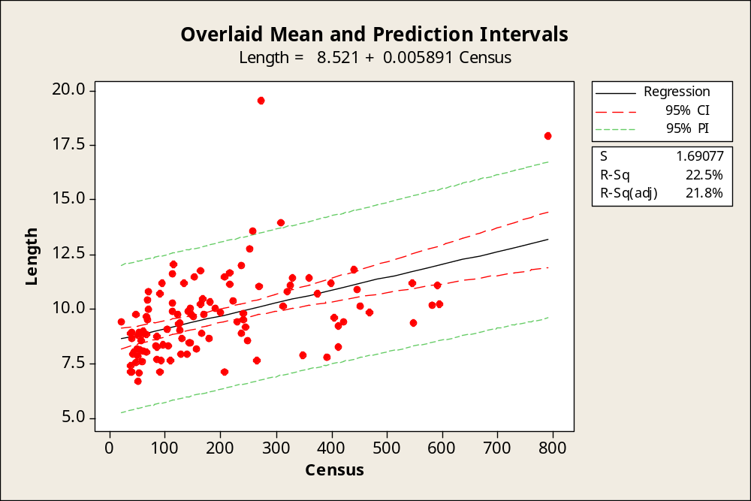

Slide 8
Conclusions
Q&A
If yes;
  Fire away;
If no;
  Good Night & Good Luck;

